Slide 1
1/10
An Implementation of Dawson Integral
Under the guidance of Prof. V. Milutinovic
Presenter - Jayendra Khandare
(jkhandar@umail.iu.edu)

Slide 2



2/10
Dawson Integral[1]
Given by function,
As it is an odd function, it can be given as,
For applying to the Complex plane, it can be modified as,
- where erfi(z) is error function and w(z) is Faddeeva function

Slide 3
Platform : Maxeler Systems
3/10
Maxeler develops hardware, software and provides other services which help to gain performance per unit of rack space.[2]
It also helps bringing down the power bill.
It is based on data-flow computing,
  Which focuses on optimizing the movement of data.
  Utilizes massive parallelism between 1000s of tiny cores
It has this concept of ‘skins’ which helps to implement the code using various languages like :
  Python
  R
  Matlab
  C

Slide 4

Implementation Details
4/10
This implementation is for Maxeler Systems and works on data-flow based model.
The base code was used from the book :
  “ Numerical Recipes in C ” [3]
The function can be summed up as :
                (eq.1)
When h is sufficiently small and n large enough,
speedup is possible.

Slide 5
Requirements for Acceleration
5/10
There are 6 requirements for a loop to be ported to data-flow model. [4]
Both of them can be accelerated since both are used
  Multiple times hence their level of re-usability is high.
  They contribute highly to the overall execution time.
The first factor in (eq.1) is accelerated in this implementation.
An outline is given for calculating the value of the third factor.
Second factor is not calculated using a loop,
hence it cannot be accelerated using data flow model.

Slide 6
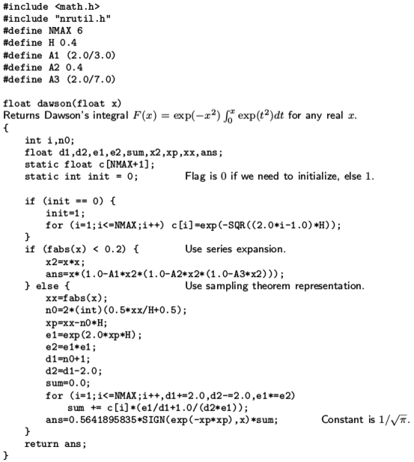
6/10
Original
C
Code[5]
Loop for first factor
Loop for third factor

Slide 7
CPUCode
7/10
First, we define all the variables and create a macro for calculating square.
Then in main function, we define arrays for data streams and some variables.
Then we calculate values for array c[ ] with the help of kernel called ‘simpleKernel’.
  Which helps to calculate first factor.
Finally, we calculate second and third factors, which can be done with a separate Kernel or simple C code.

Slide 8
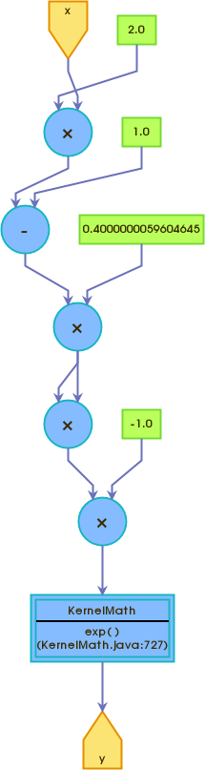
EngineCode for LOOP 1
8/10
class SimpleKernel extends Kernel {
SimpleKernel(KernelParameters parameters) {
super(parameters);
DFEVar i = io.input("x", dfeFloat(8, 24));
DFEVar H = constant.var(dfeFloat(8,24),0.4);
DFEVar temp = powSq((2.0 * i - 1.0) * H);
temp = temp * -1;
DFEVar result = KernelMath.exp(temp);
io.output("y", result, dfeFloat(8, 24));
}
static DFEVar powSq(DFEVar x) {
return x*x;
}
}

Slide 9
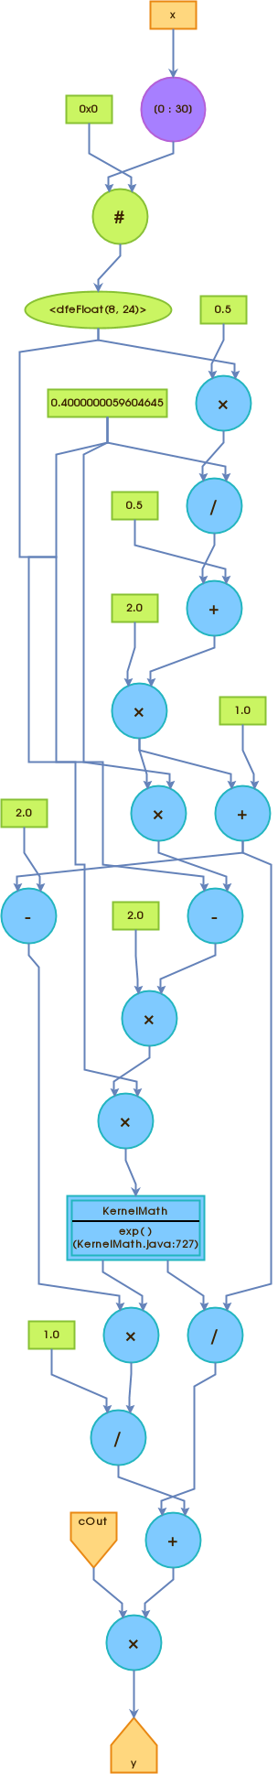
EngineCode for LOOP 2
9/10
class SimpleKernel extends Kernel {
SimpleKernel(KernelParameters parameters) {
super(parameters);
DFEVar H = constant.var(dfeFloat(8, 24),0.4);
DFEVar x = io.scalarInput("x",dfeFloat(8, 24));
DFEVar i = io.input("cOut", dfeFloat(8, 24));
// the code gets a little complicated from here,
// hence cannot explain in here
DFEVar xx = KernelMath.abs(x);
DFEVar n0 = 2 * (0.5 * xx / H + 0.5);
DFEVar xp = xx - n0 * H;
DFEVar e1 = KernelMath.exp(2.0 * xp * H);
DFEVar e2 = e1 * e1;
DFEVar d1 = n0 + 1.0;
DFEVar d2 = d1 - 2.0;
DFEVar result = i * (e1 / d1 + 1.0 / (d2 * e1));
io.output("y", result, dfeFloat(8, 24));
}
}

Slide 10
References
10/10
‘Dawson Integral’ information page maintained at
  https://en.wikipedia.org/wiki/Dawson_function
Information about Maxeler Technologies given at
  http://www.maxeler.com/
‘Numerical Recipes in C’ - The art of Scientific Computing Second Edition
  by William H. Press, Saul A. Teukolsky, William T. Vetterling, and Brian P. Flannery
Instructions provided by Prof. V. Milutinovic for porting a loop into data-flow system.
  http://home.etf.rs/~vm/os/vlsi/predavanja/maxeler.html
C code provided in ‘Numerical Recipes in C’
  on page 260(hard bound)
  on page 284(pdf copy)
  http://www2.units.it/ipl/students_area/imm2/files/Numerical_Recipes.pdf

